Slide 1
Molecular Biology Biol 480
Lecture 26 April 3rd , 2019

Slide 2
Announcements/Assignments
Attended the American Association for cancer research (AACR) meeting
Cool talk on alternative splicing! Different ancestry groups..i.e. West Africans and descendants show different splicing forms of specific genes than other ancestry groups. Relevant in the risk of developing certain cancers and in the effectiveness of certain treatments.
Exam 3—returned Friday

Slide 3
Where were we? Translation
Protein primary, secondary, tertiary, quaternary structure.
Protein domains
Protein motifs
Shared motifs in different proteins suggests exons have been moved/shuffled throughout evolutionary history.

Slide 4
Functional Domains
Domain: portion of a protein that folds into stable, unique conformations independent of the rest of the molecule
Domains give different functional capabilities
Proteins can contain one to several domains
Thought to have arisen as a result of “exon shuffling” (see upcoming slides)

Slide 5
LDL Receptor Exons
Figure 14.22
Notes:
Figure 15-22 A comparison of the 18 exons making up the gene encoding the LDL receptor protein. The exons are organized into five functional domains and one signal sequence.

Slide 6
Some common protein motifs

Slide 7
How did unique proteins come to have common domains?
Exon Shuffling…
It’s thought that new proteins have been made over time by DNA recombination and movement of DNA in the genome. In a sense, just reusing a limited number of protein coding sequences in different ways….read more on your own.
http://en.wikipedia.org/wiki/Exon_shuffling#History

Slide 8
Protein folding process
Some proteins require other proteins to fold properly. Because of this tendency for proteins to fold right away, the end terminus may fold up and be unable to form proper structure with a more C-terminal region.
Proteins called chaperones function to sort of prevent some folding of a newly made protein until more of the amino acids are available.

Slide 9
Some chaperones also serve to protect proteins from unfolding if a cell is exposed to denaturing conditions.
For example, special chaperone proteins called heat-shock proteins, serve to protect a cell from short exposures to increased heat.

Slide 10
Without these heat shock proteins some proteins would denature and likely stick together with even small increases in heat.
http://en.wikipedia.org/wiki/Heat_shock_protein

Slide 11
Moving to chapter 15
If we have a good handle on the genetic code, and protein synthesis, and on the intimate connection between amino acid sequence and folded structure and on the link between protein structure and function…
…We can pretty easily link DNA alterations---mutations, to genetic variation and natural selection, and to genetic diseases.

Slide 12
The classic example (and the first disease linked definitively to mutation) is sickle cell anemia.
This disease is the result of abnormal hemoglobin—the oxygen-carrying protein in our red blood cells.

Slide 16
Review…linking classical with molecular genetics
To begin will need to think somewhat mechanically about mutations.
Mutations are permanent changes in DNA
DNA is organized into chromosomes.
Chromosomes are located in cells…
Diploid organisms have 2 copies of each gene

Slide 17
Classification…location of mutation
Somatic mutations---occur in DNA of any cell in the body, other than germ cells (egg or sperm)
Germline mutations occur in DNA of germ cells/gametes/egg and sperm.
Autosomal mutations occur within genes on chromosomes that do not have genes that determine sex development.
Sex-linked mutations occur within genes on chromosomes that do have genes that determine sex development.

Slide 18
Recall…in diploid organisms…
Depending on the function of the protein encoded by the gene…mutations can be:
Dominant---giving a phenotypic change if one copy of the gene is mutated
Recessive---having no effect unless both copies of the gene have mutations.

Slide 19
Dominant mutations…
Thinking in terms of the protein encoded…
The mutant phenotype may be the result of haploinsufficiency. One normal copy of the gene may be unable to produce enough of the protein for normal function of the cell.
The mutant phenotype may be the result of a dominant-negative effect. The abnormal form of the protein may inhibit the activity of the normal form of the protein.

Slide 20
Recessive mutations---no noticeable effect (if only one allele is mutated) because a normal copy of a gene provides a normal copy of the protein. There seems to be no difference between one and 2 copies of the normal protein.
Only when both alleles are mutated, and no normal form of the protein is produced is there noticeable effect on the cell/organism.

Slide 21
Example? Instances occur where a region of a chromosome is lost---if this occurs in both copies of the chromosome, BOTH copies of a gene are lost---no protein encoded by this gene can be made.
(go beyond thinking of a recessive allele as a small letter!)

Slide 22
At the molecular level…
Point mutation—a change in one nucleotide in a gene. Also known as a base substitution.
3 outcomes in terms of the protein produced.
Substitution changes the triplet code to encode a different amino acid= missense mutation
Substitution introduces a stop codon in the protein code=nonsense mutation
Substitution changes the triplet code to a different code, but which encodes the same amino acid or a functionally similar amino acid= silent mutation

Slide 23
Nucleotide substitutions are sometimes classified by the change made.
If a purine is substituted for another purine or pyrimidine for a pyrimidine, it is called a transition mutation
If a purine is substituted for a pyrimidine or vice versa, it is called a transversion mutation

Slide 24
Frameshift mutation– insertion or deletion of 1 or 2 nucleotides, which completely changes the reading frame of the protein.
Figure 15-1---
Why are frameshift mutations generally more serious than point mutations?

Slide 25
Be able to describe this as a molecular change…not just an English sentence…
Figure 16.1
Notes:
Figure 16-1 Analogy of the effects of substitution, deletion, and insertion of one letter in a sentence composed of three-letter words, demonstrating point and frameshift mutations.

Slide 26
Functional classifications of mutations
Loss of function mutations---as expected, these types of mutations completely eliminate the normal function of the protein encoded by the gene.
These can result from point mutations, frameshift mutations, large deletions of DNA including the gene.
Sometimes called null mutations

Slide 27
Loss of function mutations can be dominant or recessive---see earlier slides---and read more!

Slide 28
Gain of function mutations. As the name implies, these mutations change the protein in a way that gives in a new activity or so that it is made in excess and this greatly enhances its effect in a cell.
These mutations are usually dominant.

Slide 29
How do mutations arise?
2 primary ways:
Mistakes by DNA polymerase, during replication.
Insertion of a non-complementary base to the template (with a failure to correct)
DNA polymerase slippage or stuttering that ultimately misses some nucleotides or duplicates some region of the DNA
Base changes which occur in existing DNA

Slide 30
Some common base modifications
Tautomeric shifts
DNA bases can exist in 2 forms, isomers, that differ only in the position of one proton. These different forms are known as tautomers.
These spontaneous shifts allow non-Watson-Crick base pairs to form.

Slide 31
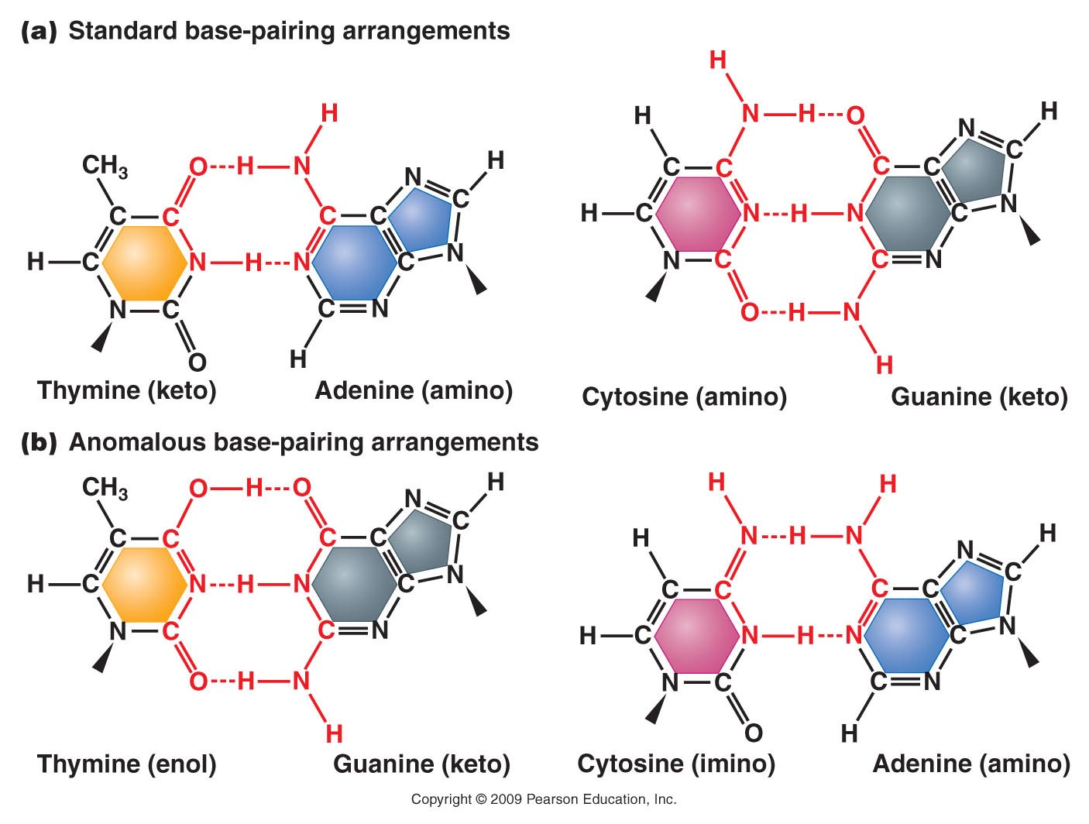
Figure 16.2
Notes:
Figure 16-2 Standard base-pairing relationships (a), compared with anomalous base-pairing that occurs as a result of tautomeric shifts (b). The long triangle indicates the point at which the base bonds to the pentose sugar.

Slide 32
In the next round of replication, a permanent base-change will occur and half of the replicated DNA will have a point mutation.

Slide 33
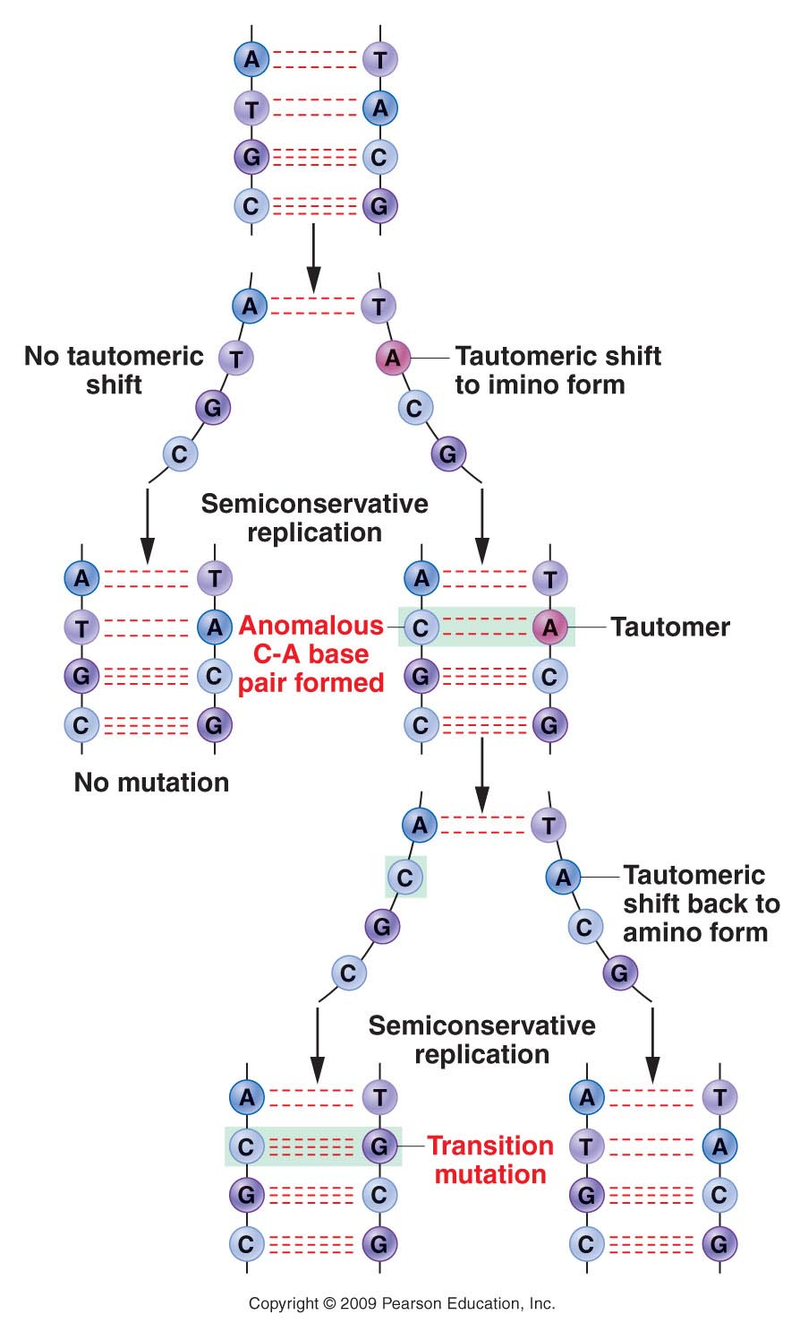
Figure 16.3
Notes:
Figure 16-3 Formation of an A=T to G=C transition mutation as a result of a tautomeric shift in adenine.

Slide 34
It’s a great time to pause and remember, that cells have a mechanism to try to reduce the overall number of times they replicate their DNA.
What is that mechanism?
A cell which is stopped from replicating will not pass on this mutation!

Slide 35
Other small chemical changes…
Common spontaneous chemical changes completely change a base (and thus its base-pairing behavior), or alter a base such that it is replaced with a random nucleotide.
Depurination
Deamination

Slide 36
Depurination

Slide 37
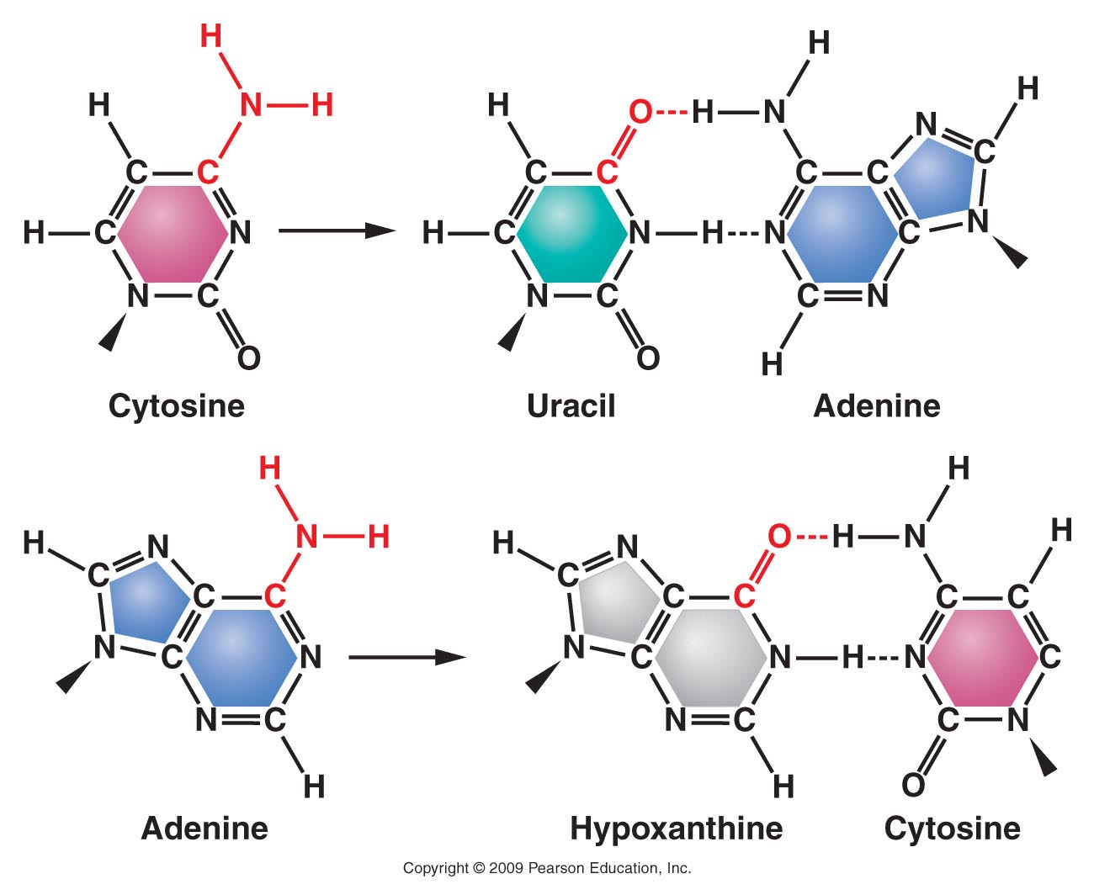
Deamination
Figure 16.4
Notes:
Figure 16-4 Deamination of cytosine and adenine, leading to new base pairing and mutation. Cytosine is converted to uracil, which base pairs with adenine. Adenine is converted to hypoxanthine, which base pairs with cytosine.

Slide 38
Independent study
Chapter 15
Since we mentioned various aspects of DNA repair when discussing DNA replication, we will read independently through section 15.7.---- know what the Ames test is for!

Slide 39
But how do mutations arise…
In both cases, mutations can be:
Induced---Caused by an external factor or condition of the cell. For example, UV light causes/induces pyrimidine dimers to form. Limiting sun exposure reduces this type of mutation associated with skin cancer!
Spontaneous—unavoidable, random changes not associated with any specific agent or condition.

Slide 40
Different organisms seem to have different spontaneous mutation rates:
Bacteria show an average of 1 mutation in 100 million DNA replications/cell division. (10⁻⁸)
Mice ~(10⁻⁵)
Humans (10⁻⁶)

Slide 41
This oversimplifies things a bit---within an organism’s genome, there are regions that are nearly resistant to mutation, and other regions that are fairly frequently mutated.
These regions of higher rates of mutation are sometimes called “hot spots” for mutation.

Slide 42
It’s also a good time to remember, that all we’ve learned about induced and spontaneous mutations, has helped us in instances when the goal is to:
Induce mutations for the purpose of studying mutants in a particular process
Kill cells purposely by inhibiting normal replication and DNA chemistry/structure.

Slide 43
For example
Exposing a plate of bacteria to UV or other radiation leads to mutation (induced) in some individuals.
If you are studying, say, mutations associated with metabolism of arabinose, you can select for those that change in terms of how they use arabinose.

Slide 44
Likewise…
Studying how radiation results in mutation (and leads to apoptosis) led to the development of radiation treatment for cancer.
Chemicals that bind DNA and disrupt DNA replication or result in mutations are common cancer chemotherapy drugs.

Slide 45
Be sure to review mutagens, mutation rate, assays to identify mutagens.

Slide 46
One final thought…Why would an error free replication system or a mutation-resistant genetic material be a bad thing…Why is it essential to have a low, but detectible mutation rate?

